Slide 1
Project Title AI-Powered Doctor Appointment Booking & Virtual Receptionist System
Name: Arshad Abdulmajeed Perampalli
Course: B.Tech(Artificial Intelligence & Data Science)
Year of Study: UG Final Year
College: N.K Orchid College of Engineering & Technology Solapur
Email ID: perampalliarshad123@gmail.com
Contact No.: 8626080297

Slide 2
Contents
Lean Canvas
Concept Note
Introduction
Workflow
Result
Conclusion

Slide 3
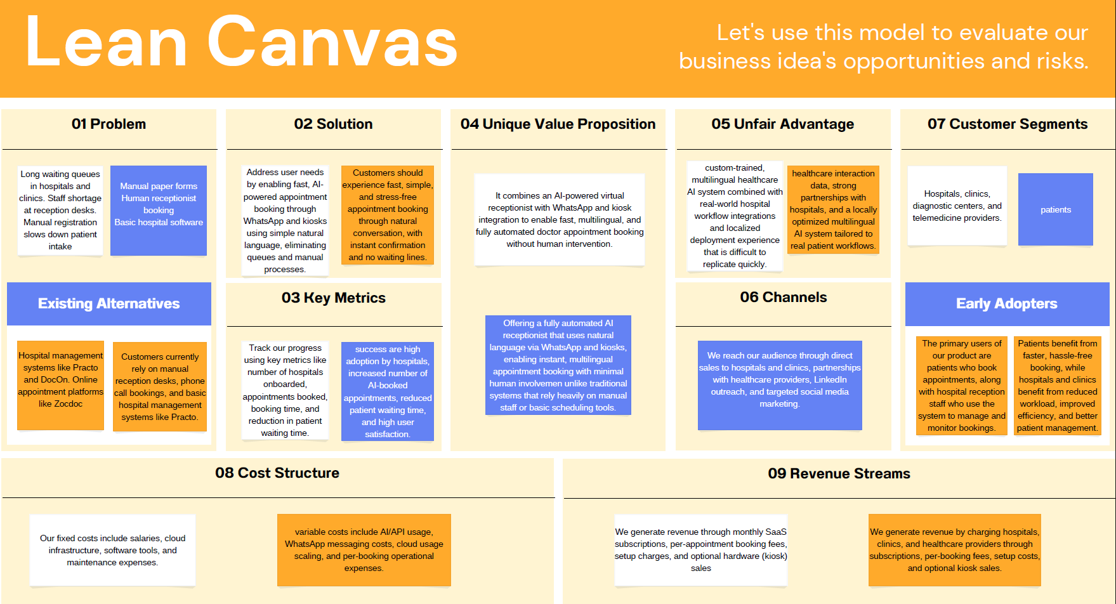
Lean Canvas

Slide 4
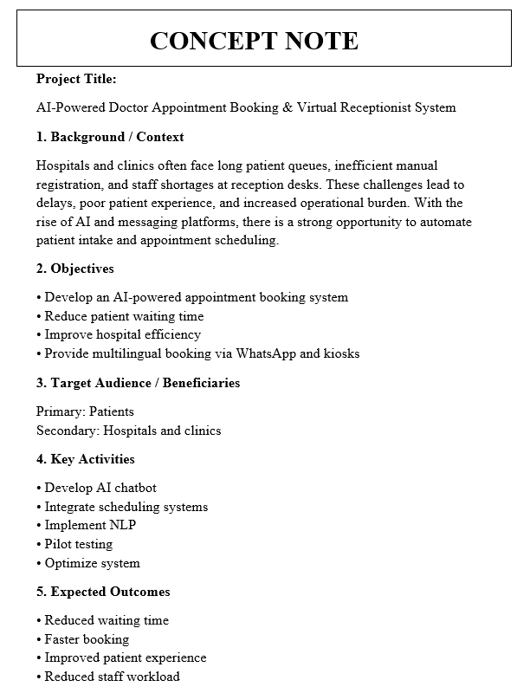
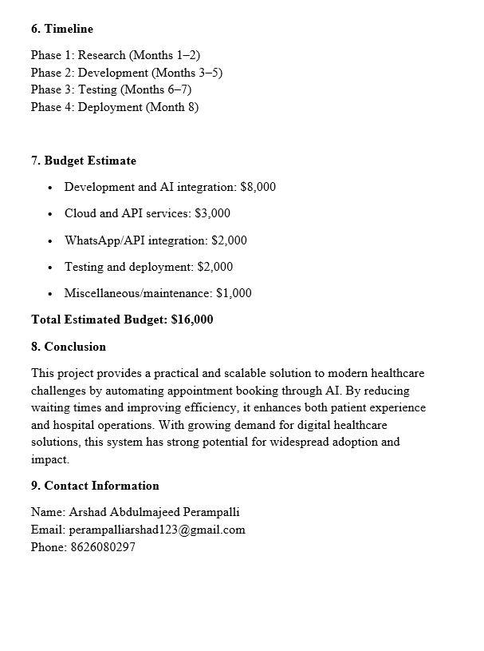
Concept Note

Slide 5
Introduction
Healthcare systems today face significant challenges such as long patient queues, manual appointment booking, and staff shortages at reception desks.
These issues lead to delays, inefficiencies, and poor patient experiences, especially in high-volume hospitals and rural areas.
Our AI-powered virtual receptionist streamlines this process by enabling fast, automated appointment booking through WhatsApp and kiosks, significantly improving operational efficiency and enhancing the overall patient experience.

Slide 6
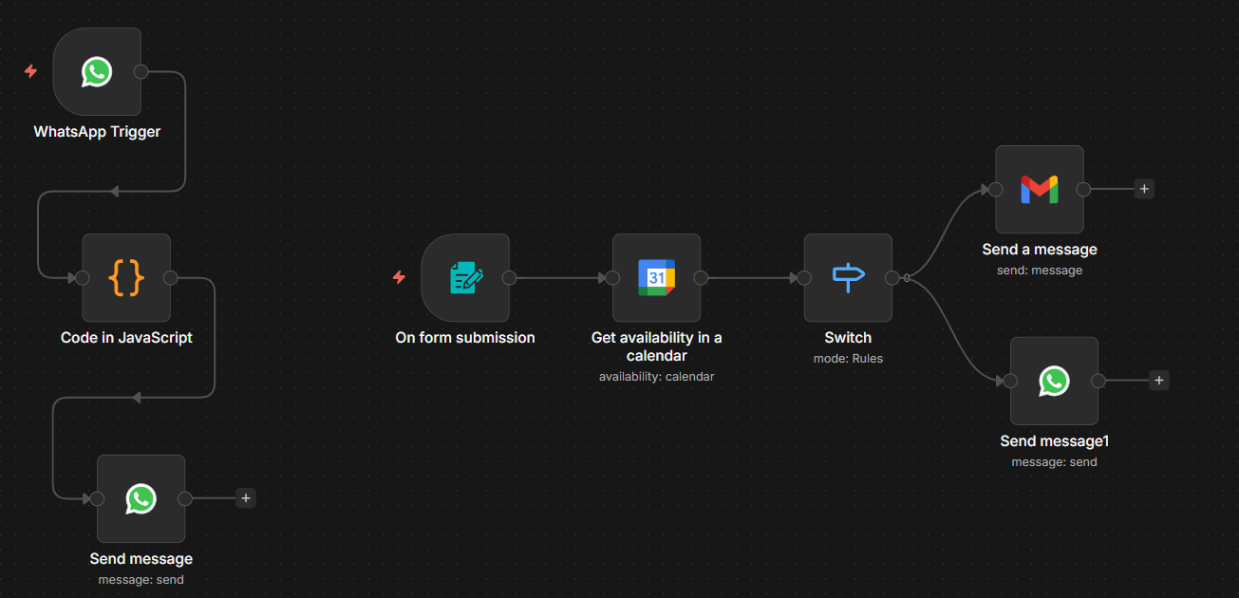
Workflow

Slide 7
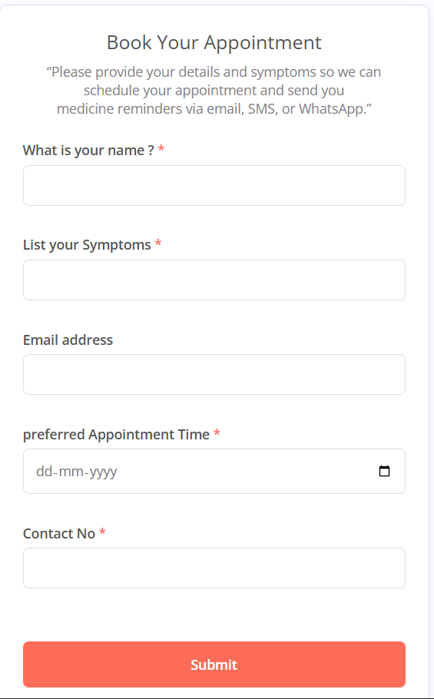
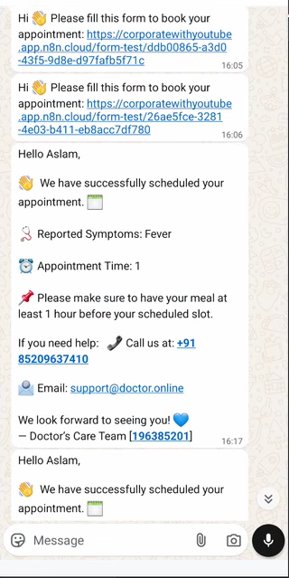
Result

Slide 8
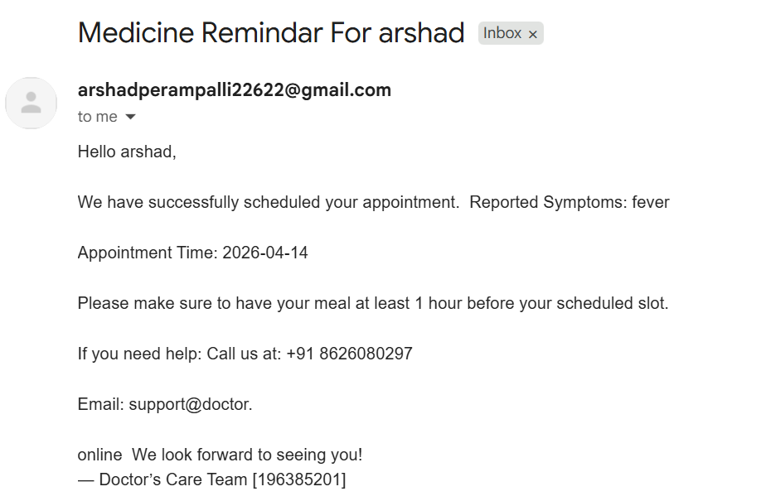
Result

Slide 9
Conclusion
This project presents a scalable and efficient solution to modern healthcare challenges by automating appointment booking through AI.
By reducing waiting times, minimizing manual work, and improving patient experience, it has the potential to transform how hospitals manage patient intake and operations.
This solution transforms healthcare by eliminating queues, automating bookings, and delivering faster, smarter patient experiences.
GitHub Link: https://github.com/Arshad-5068/AI-Powered-Doctor-Appointment-Booking-/tree/main

Slide 10
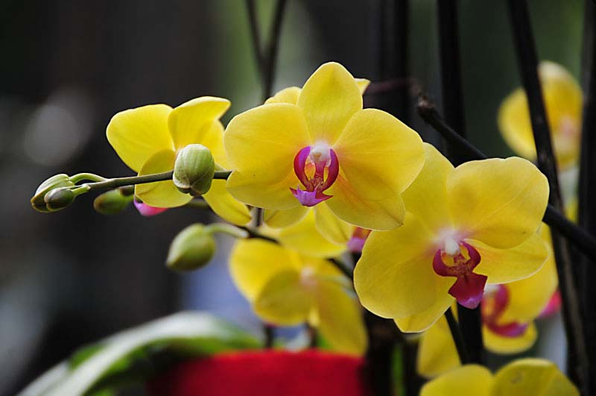
Thank You

